Slide 1

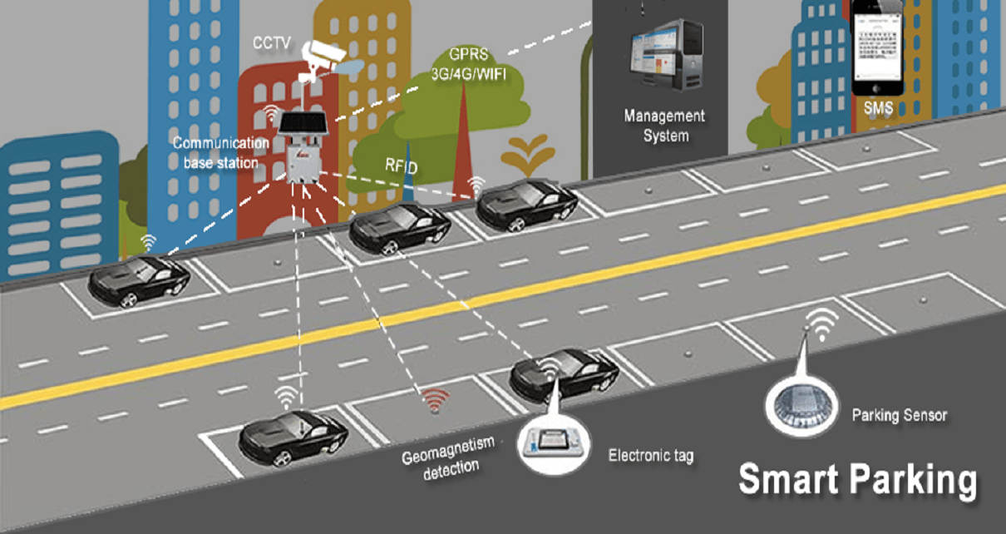
Brijesh Prajapati
AWS Solutions Architect/DevOps
Orlando, FL
Mobile: (407) 405 7979
Email: it.brijesh@gmail.com
Relevant Experience
Worked as AWS Solutions Architect for the design, review & re-architect of Industry 4.0 Smart factory solutions utilizing AWS Cloud web services and also migration of existing legacy applications on AWS.
Hands on experience on setting up CICD pipeline for AWS Cloud Serverless Microservices including S3, DynamoDB, RDS, API Gateway, Websockets, IoT core, Events & Rules engine, Step function, Kinesis and related services utilizing AWS Code commit, build & pipeline for Blue/Green & Canary Deployment.
Hands on experience on building the code using maven and setting up CICD Pipeline utilizing Jenkins, GitHub/BitBucket, Nexus/Jfrog/ECR Repositories for automated artifact store, Selenium/Sonar cube for automated testing.
Hands on experience on building Docker containers for Java, NodeJS, Python & Spring microservices and deploying the same for orchestration into Kubernetes cluster for Blue/Green and Canary deployment.
Hands on experience of deploying applications on AWS Cloud including EC2, S3/CloudFront & Container services such as ECS & EKS for Blue/Green & Canary Deployment including Auto Scaling & Load Balancing.
Hands on experience on setting up AWS Cloud infrastructure using Ansible & CloudFormation including VPC, EC2, S3, RDS, SNS, ELK and related services.
Brijesh is an enthusiastic software professional with 12+ years of hands-on experience in all phases of Software Development Lifecycle. He has worked as a developer, module leader, production support lead and Technical/Framework Architect & DevOps Engineer.
He has in-depth knowledge of DevOps tools & ecosystem and has helped implement various automated CI/CD pipelines. In addition to that he has extensive knowledge on Java/J2EE with hands-on working knowledge in Spring, Hibernate, Web services & related technologies and has designed, architected and implemented Web application frameworks.
He has in-depth understanding and working knowledge of AWS and has been actively building competency in IoT/IIoT, DevOps and Blockchain.
Education / Certifications
Tools / Technologies
B.E ( Information Technology )
Associate AWS Certified Developer
Professional AWS Certified Solutions Architect
Professional Oracle Certified, Java SE 7
AWS IoT Foundation, Greengrass Premier – Edge Computing
AWS Cloud – S3, DynamoDB, Lambda, API Gateway, RDS, EC2, DynamoDB, Kinesis – streams, firehose, analytics, IoT Core, Rule Engine, Greengrass, IoT Events, Step functions
CloudFormation, AWS SAM, Ansible, Jenkins, AWS Code Commit, Build, Deploy & Pipeline, Nexus. Jfrog. GitHub/BitBucket, Confluence
Java, J2EE, JSP, Servlet, Spring framework, Hibernate, Spring boot & Cloud with Config, Eureka Registry, Zuul, Security with Oauth & JWT.

Slide 2
Demo Topics
Overview/Problem Description
Software/Hardware/Cloud/Technology Specifications
AWS Architecture – Advanced & Simplified (Part of Capstone project)
Sequence/Data Flow diagram/Deployment architecture
AWS Infrastructure Resources created
EC2, RDS, Lambda, DynamoDB
IoT Core, Greengrass, Rules Engine, IoT Events/State Machine
APIs, CloudFront
DevOps CICD Pipelines
EKS Jenkins Pod, CloudFormation, Terraform
AWS CodePipelines
Live Demo with Python Device Simulation scripts
Sensor Device Registration
Parking Occupied
IoT Event/State Machine model for Battery Status

Slide 3
Problem Description:
The city of Round about has a downtown parking problem. Motorists find it hard to find parking even though there are many metered parking street spots in and around the downtown area.
The problem is worse during the peak demand hours of weekday mornings and weekend evenings.
The free parking spots are not always easy to locate.
This leads to a number of motorists roaming around looking for parking which makes the problem worse by creating additional traffic congestion.
Impact:
Help local Government to achieve goal of Smart City/Smart Nation
Company can build reusable solution and develop 3rd party APIs for custom app development
Alliance with AWS for Solution Marketing
Alliance with Sensor Device Hardware companies, Shipping Companies
Supply Chain Network? Digital Twin? …

Slide 4
Software/Hardware/Cloud/Technology specification
Hardware/Sensor technology to identify if a parking spot is occupied.
Microcontrollers
Ultrasonic/IR Distance Sensors ( SparkPlug compliant devices )
Camera for Car object/Vehicle Number Plate detection
RFID Scanner for parking booking
Connectivity technology to transmit current state of the parking spot.
LPWAN
A scalable Sensor data processing/ingestion in AWS cloud to maintain parking data.
AWS Greengrass, IoT Core, Rule Engine, AWS Lambda
Ignition Edge & Gateway
ThingWorx Kepware server
Python scripts for Device Simulation
Parking data is made available to 3rd party app developers to build interesting parking applications.
RDS, DynamoDB, AWS Lambda, IoT Events, API Gateway, S3, CloudFront
AWS Amplify NodeJS/Angular application
Infrastructure & Code setup
Single Click deployment of infrastructure & code using CICD pipelines
EKS based Jenkins server, Terraform, CloudFormation, AWS CodePipeline
Platform security & data protection.
MQTT, SSL, X.509, IAM Roles, Cognito/JWT Oauth
EC2 & RDS on Private Subnets only
AWS SSM for login to EC2/RDS

Slide 5
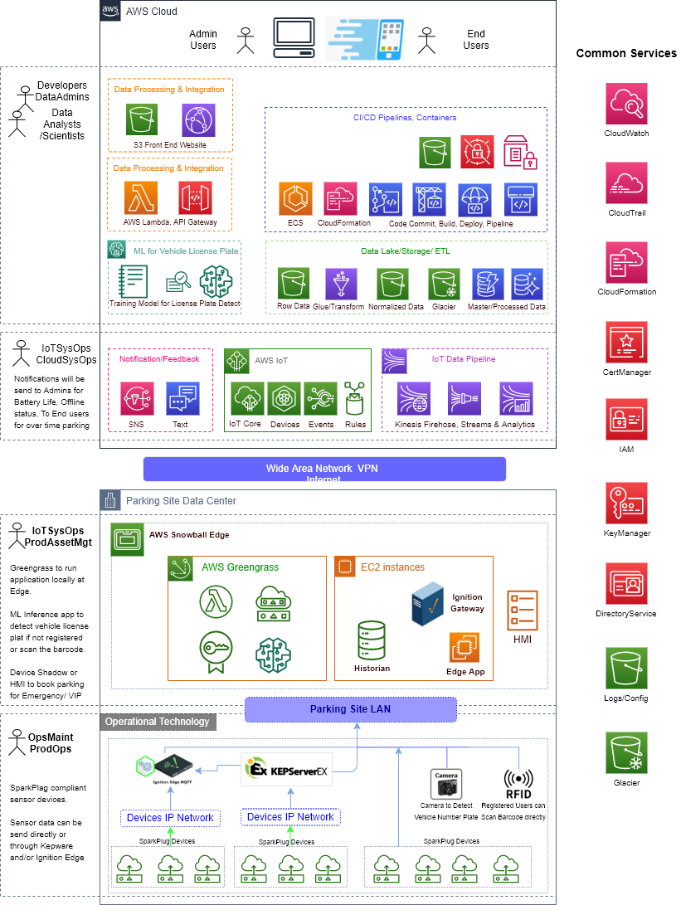

Slide 6
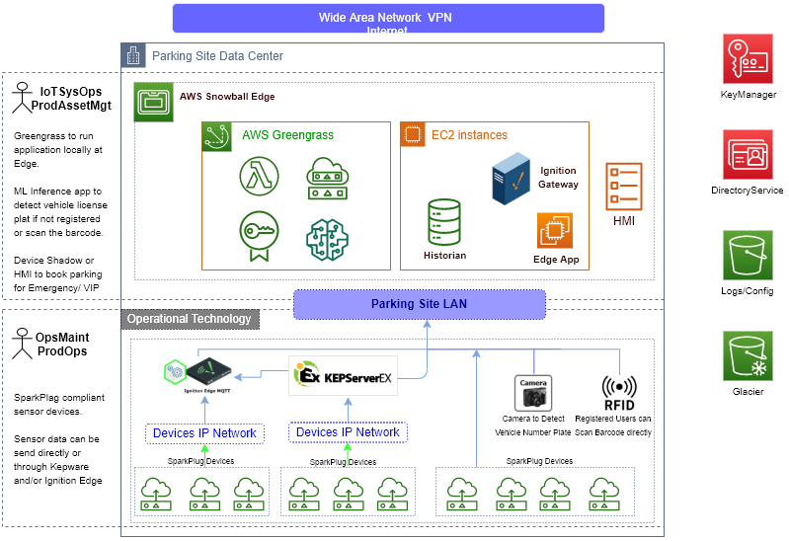
AWS IoT Advance Architecture

Slide 7
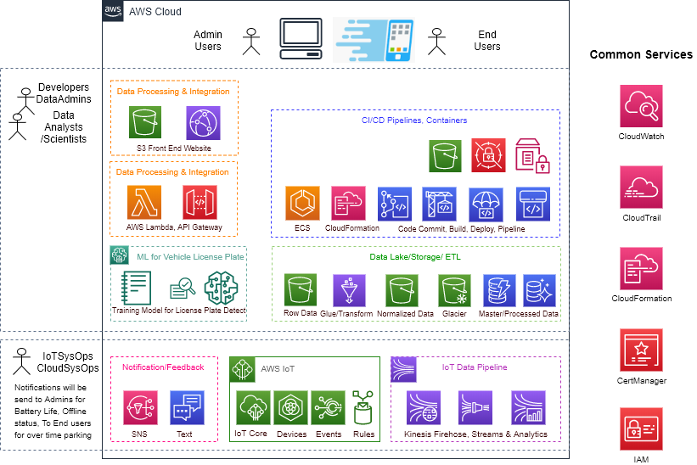
AWS IoT Advance Architecture

Slide 8
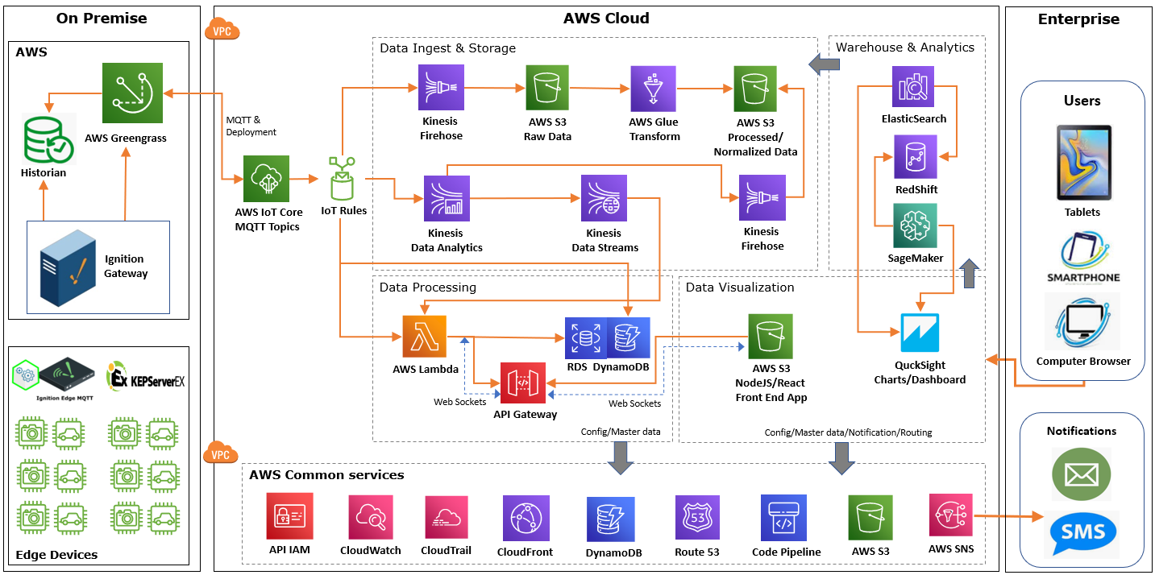
AWS IoT Advanced Architecture

Slide 9
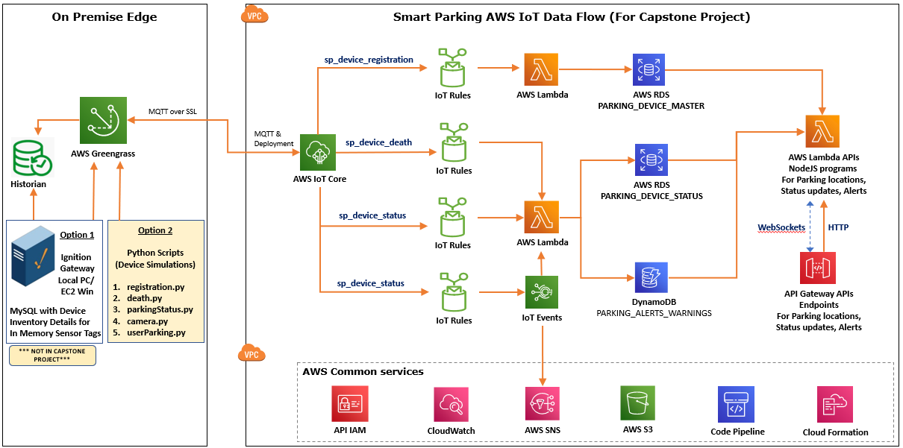
AWS IoT Simple Architecture for Capstone Project

Slide 10
Few Scenarios of sending Device Status Update Data:
Sending sensor device battery life status at regular frequency.
Sensor Data: BatteryLife, serial_number (device unique id)
Greengrass code can be updated to control data send to AWS Cloud. ( Status threshold lower limit = 40, upper = 90 )
Sending parking occupancy status (IsOccupied) on event change.
Sensor Data: IsOccupied, serial_number
Sending user action on parking. Registered user will scan and provide parking hours.
Sensor Data: user_code, parking_hours, serial_number
Edge Camera Inference will be used to detect object to double check parking is available. ( every 15 minutes )
( Helpful if device sensor not working due to some reason, OR Someone trying to cheat device )
Sensor Data: IsOccupied, serial_number
Edge Camera Inference will be used to detect Vehicle License Plate Number if user did not check-in parking.
Sensor Data: user_code (license plate number), parking_hours (default 1 hour), serial_number

Slide 11
AWS IoT Events can be used to log various Parking/Device Events:
Parking Device Distance Sensor Low Battery Power/Life
Past Parking Hours
Parking Edge/Device Maintenances
Parking without user scan or registration
Parked Vehicle License Plate Number not identified
Parked Vehicle License Plate Number mismatch with user registration
Parking Device Camera not working
Parking Device Distance Sensor not working
Note: Have implemented first event only as a part of this IoT sample assignment.

Slide 12
Future Scope:
Need to implement this IoT application based on the proposed Advance Architecture.
Inform user for over time parking via Text/Call. Add support to extend the parking hours via Text/Call.
Call Tow Away company for overtime parking violations to Tow vehicle and inform user for the same.
Detect the nearest parking via user App through GPS.
Voice support to find nearest parking site while driving. User has to go actual location for confirmed parking. (Online booking will not be supported)
Handling Emergency & VIP Parking requests. (Device Shadow or similar technique)
Creating batch programs to calculate dynamic parking rates.
- Users parking vehicle without registration will have more rates as system has to detect the vehicle
license plate number and have to call respective 3rd party services to identify user
- Users providing proper parking hours and following the parking timings should get discounted rates.
Machine Learning Vision IoT Inferencing & Training modules for Vehicle Object detection &
License Plate Number identification.
Support of Blockchain to log user parking events & cryptocurrency payments.

Slide 13
Lessons learn :
Code/Infrastructure Automation as I had to move between accounts
IoT Event State Machine
AWS Amplify framework for Web app development & Authentication
Connecting to Private EC2 & RDS using SSM & SSH tunneling
Next Action Item :
Connect to IT.BRIJESH@GMAIL.COM for Simulation Demo

Slide 14


Thank You!

Slide 15
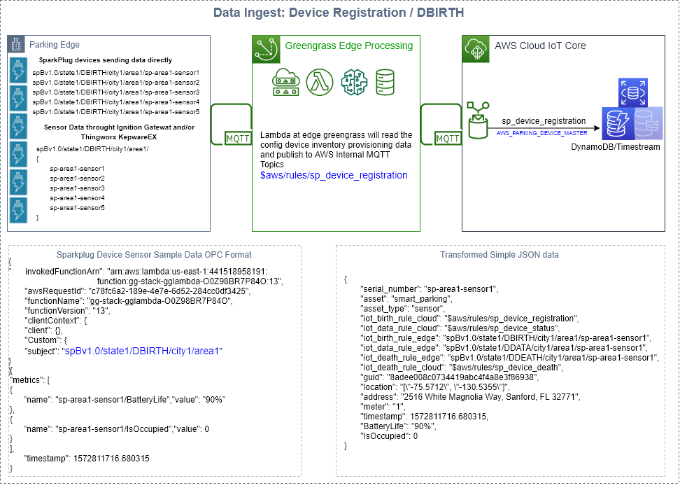

Slide 16
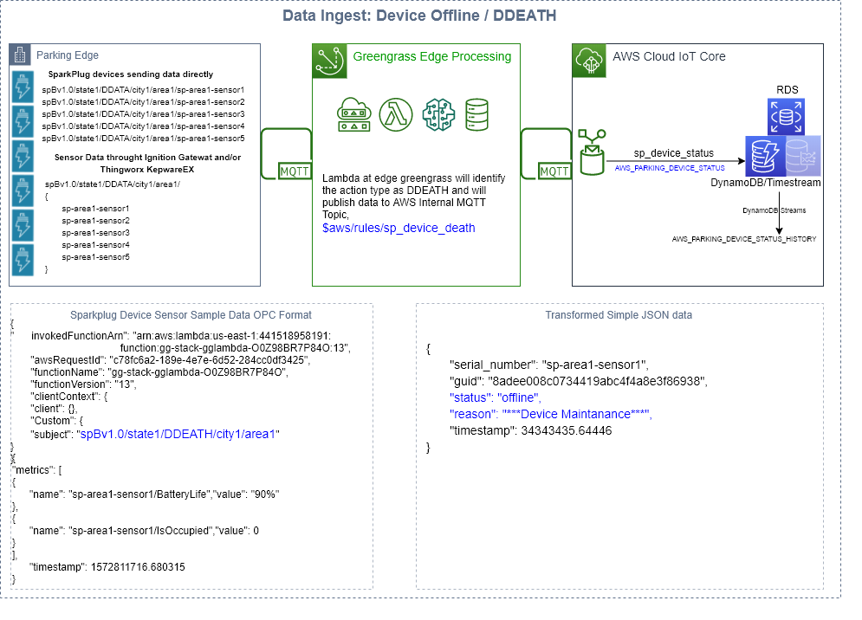

Slide 17
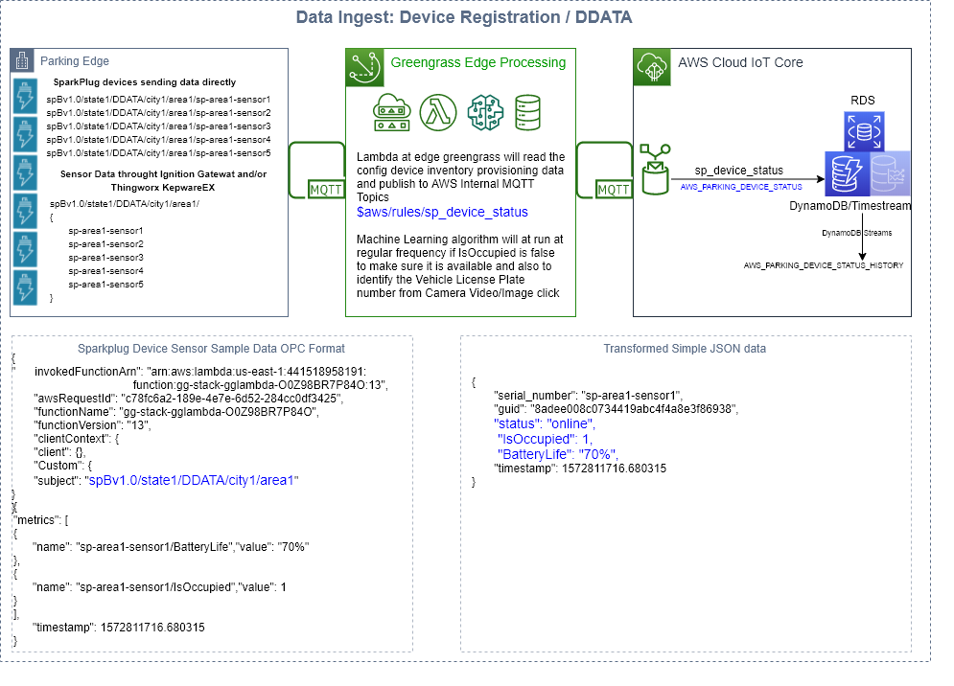

Slide 18
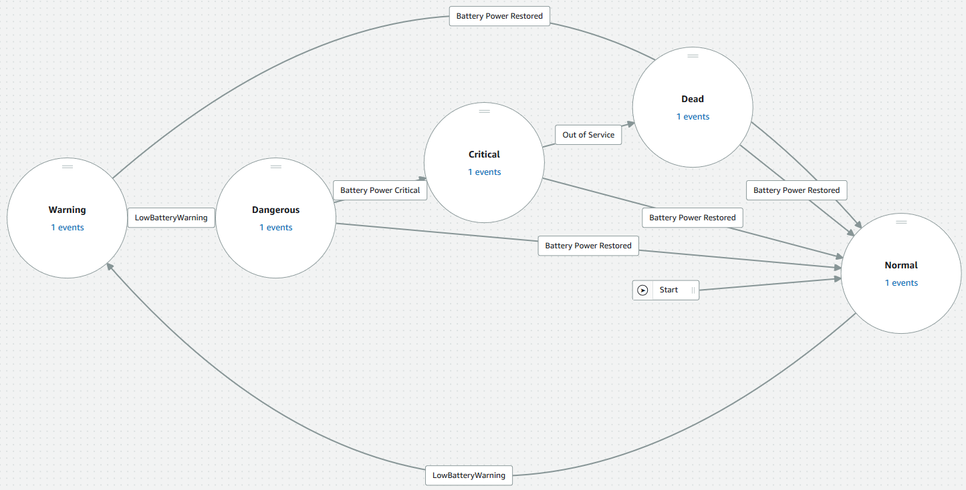
AWS IoT Events Device Battery Status Detector Model

Slide 19
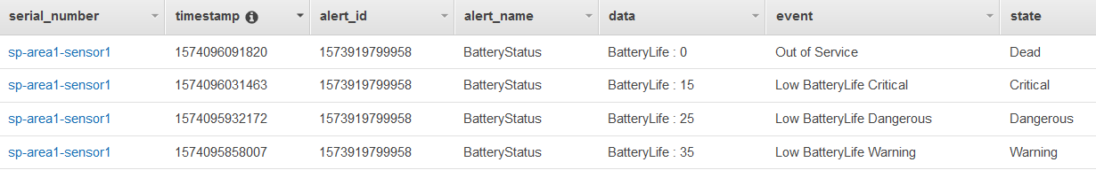
AWS_PARKING_ALERTS_WARNINGS (Testing Data)

Slide 20
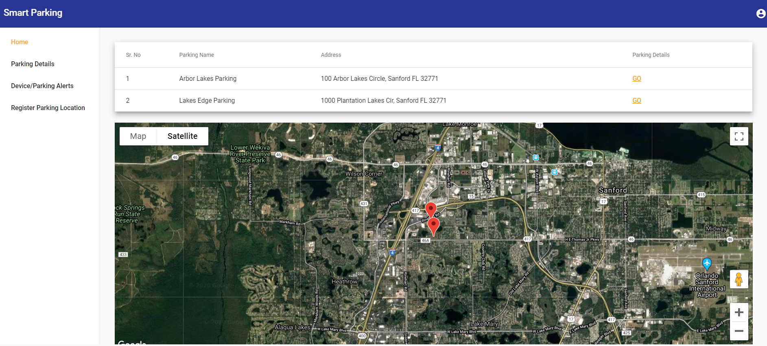

Slide 21
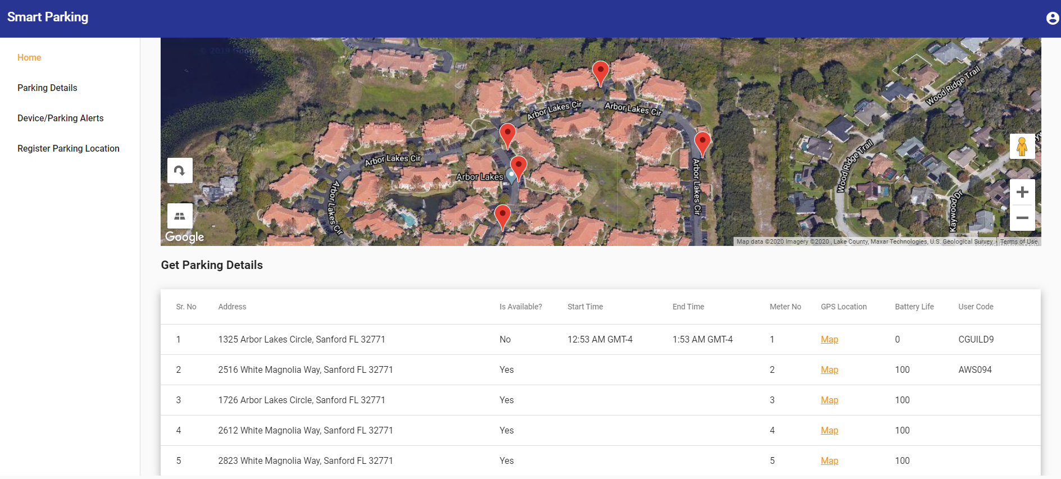

Slide 22
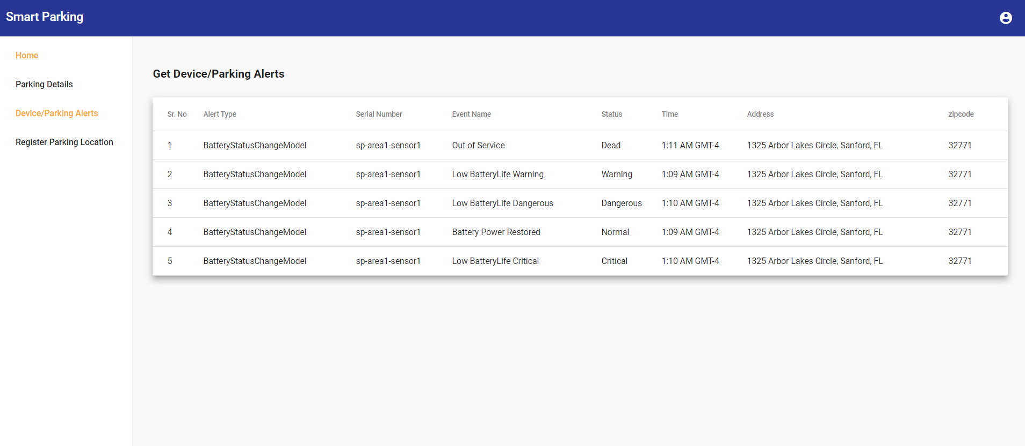

Slide 23
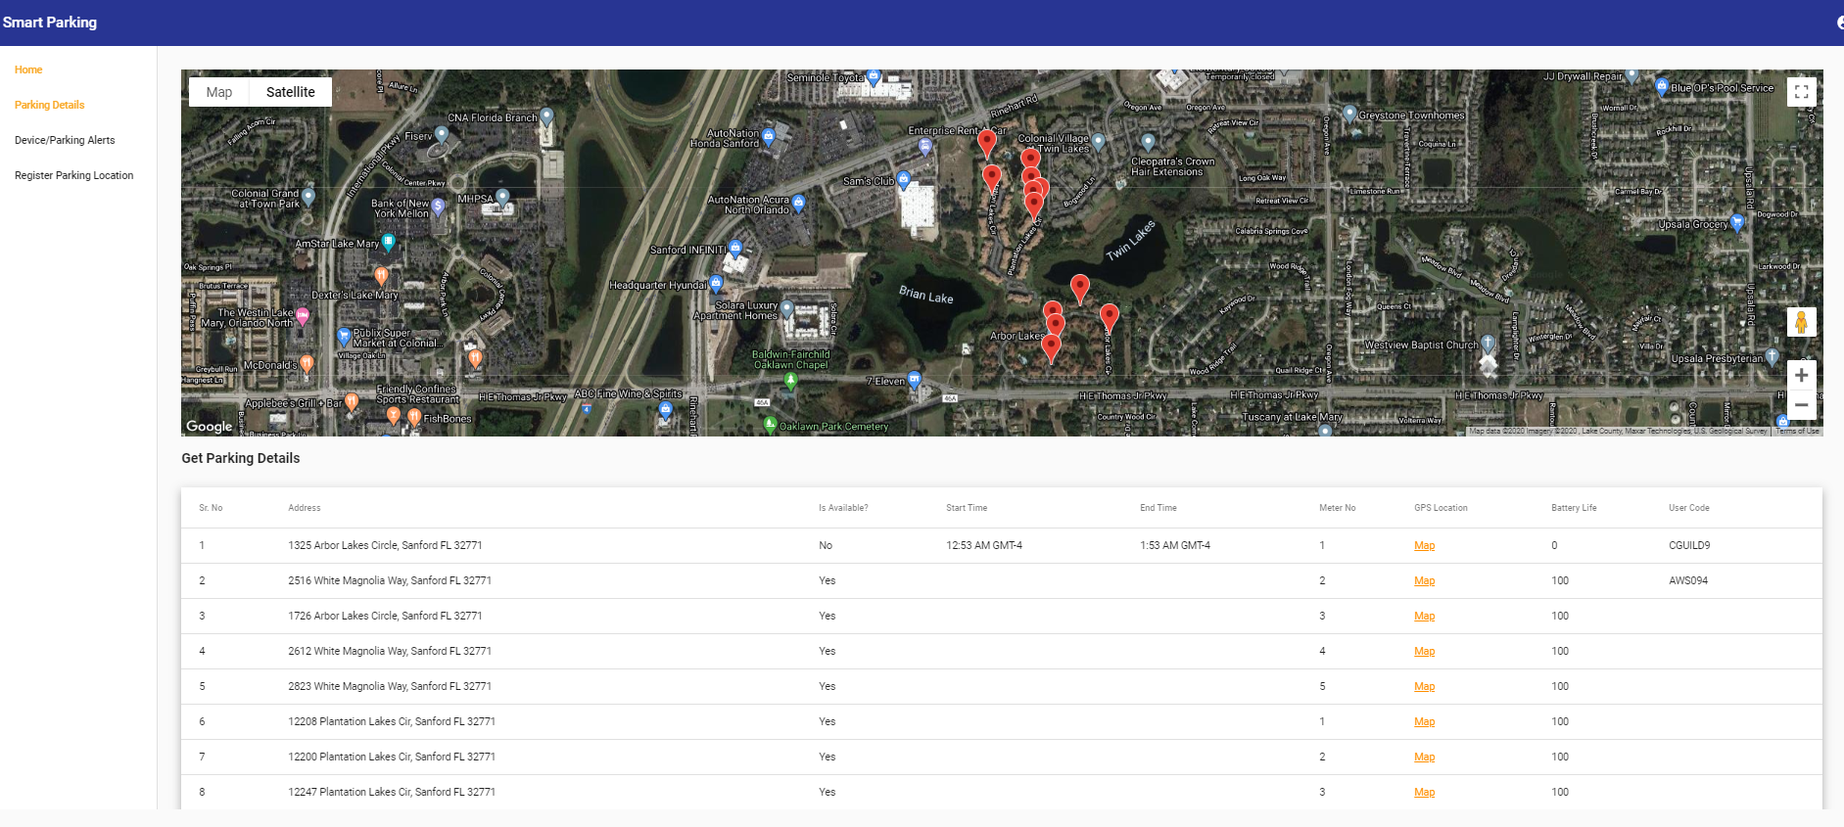

Slide 24
